Slide 1

Welcome and Introductions

Slide 2
Three Main Executive Functions
Executive Functioning
Mental process that helps you carry out goals.
Working Memory
Cognitive Flexibility
Inhibition Control
Cleveland Clinic. (2024, March 15th). What is executive function? Executive Function.
https://my.clevelandclinic.org/health/articles/executive-function.
Notes:
-Important to clarify what is Executive Functioning and its three main functions.

Slide 3
What do students need Executive Functioning Skills for?
What are Executive Functioning Skills?
Cognitive capacities that enable you to successfully manage activities of daily living.
Schoolwork
Homework
Behavior
Dawson, P., & Guare, R. (2014). Interventions to promote executive development in
children and adolescents. In S. Goldstein & J. A. Naglieri (Eds.), Handbook of
executive functioning (pp. 427–443). Springer Science and Business Media.
Notes:
-Students need skills to perform their Executive Functioning. There are three main areas where these skills are needed. For this group: Schoolwork is Project Development, Homework is the work that goes into completing the project.

Slide 4

A Day in the Life

Slide 5

Testing Your Knowledge
Notes:
-This is an assessment of what teachers know about Executive Functioning Skills. Ask teachers to take out phones or laptops to participate.
-Ask, “Why are EF Skills important for your students’ project development and competition?” Have teachers respond out loud.

Slide 6

Group Breakout
Evaluate Student Work
Use Question Guide
Use EF Skills Cheat Sheet
Prepare to share out
Notes:
-Using the EF Skills Cheat Sheet, go over all the EF Skills students need to be successful. Ask, “How many of these skills have you observed?” “Can you provide an example?” “Were you aware these EF Skills are needed for student success?”
-Every teacher was asked to bring an example of student work.
-Teachers should use the Question Guide to evaluate student work.
-Teachers need to discuss within their groups.
-Each group should be prepared to share what they found in this evaluation. Questions to ask: Are their common Executive Functioning Skills you think are needed to complete these projects? Were there any projects that were not completed? If so, why is that? What skills do think students lack that led to their projects not being completed?

Slide 7
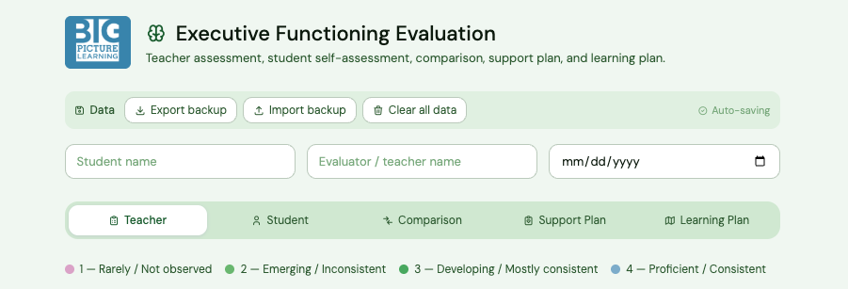
Evaluation Tool
Notes:
-Bring up the evaluation tool. Everyone should bring this tool up on their computer. The HTML file needs to be shared prior to the workshop.
-Walk them through the evaluation tool accompanied by the EF Skills Cheat Sheet.
-Have teachers look over the support plan and learning plan tabs. Ask, “How will knowing which EF Skills your students need to develop support their learning goals?”
-Cognitive Strategies (tools) are needed
-Remind them that it is important that students are developing these skills with their help. It is important for students to also complete their self-assessment. The tool has this built in. The tool will compare.
-Teachers should spend time reviewing it and practicing with it.

Slide 8
Cognitive Strategies
The tools or processes used to complete a task or solve a problem.
Metacognition
Assessment of one’s cognitive strategies.
Notes:
-Introduce these two ideas.

Slide 9
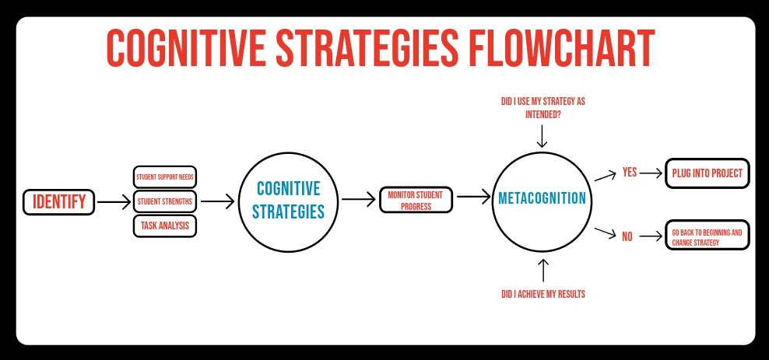
Notes:
-This flowchart helps teachers support their students.

Slide 10
Steps to develop Cognitive Strategies
Use the Evaluation Tool.
Task Analysis
What are the project needs?
Identify your student’s strengths.
Pick a tool with student.
Monitor Student Progress
Evaluation with student

Slide 11
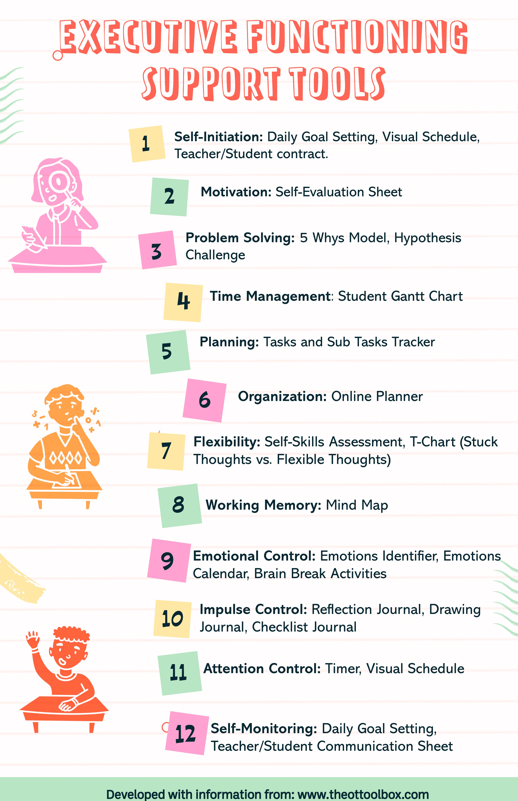
Students need tools for Cognitive Strategies
Visual
Diverse Options
Tangible Products
Plug-In Information
Alignment with Goals
Support Student Skill Gaps
Take Action on their own
Notes:
-Introduce them to this Infographic.

Slide 12
Metacognition
Student Self-Reflection
What did I need to do?
What tool did I use?
Did I complete my project?
Notes:
-Students need to reflect on the tool they used. They need to ask these 3 questions of the tool and if it’s a strategy that worked.

Slide 13
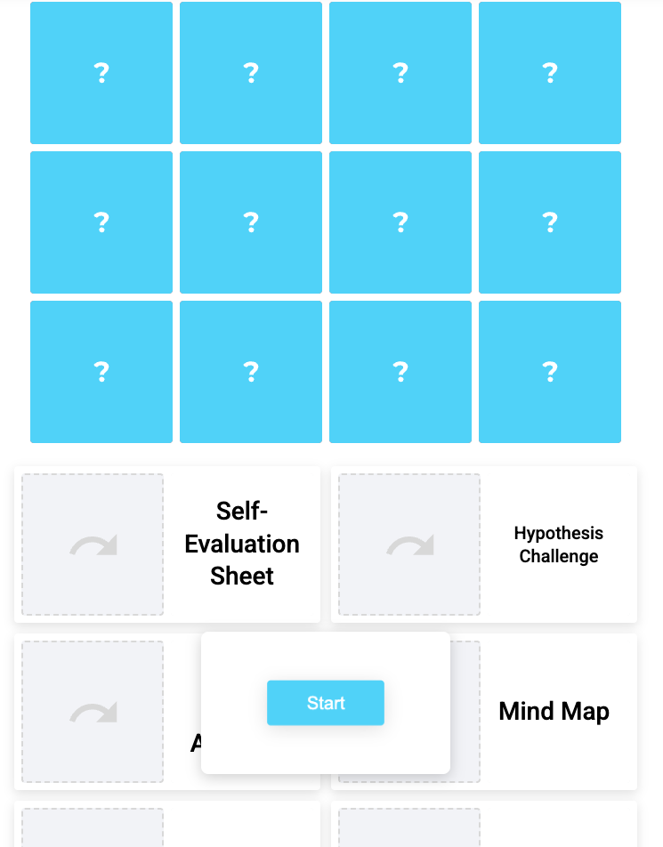
What do you remember?
Notes:
-Give the quiz where they must match a tool with the Executive Functioning Skill.
-This quiz is timed. They can use their phones or computer.

Slide 14
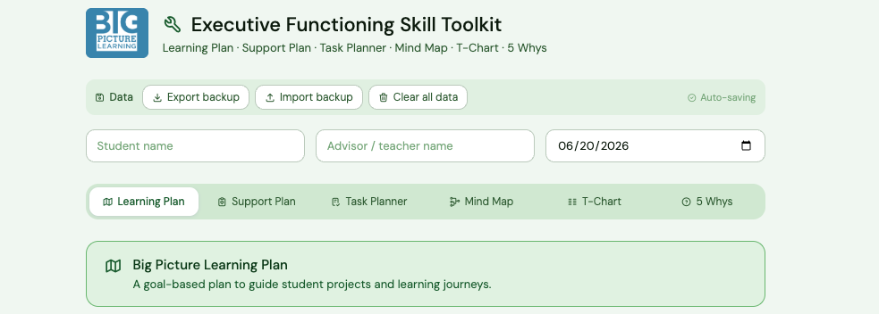
Building Your Tools
Notes:
-Teachers will go back into their groups, review the toolkit that was provided them, and they must select a tool to create from the EF Tools Infographic.
-They will upload to a cloud based system so everyone will have access in the future.

